Slide 1




H E L L O

Slide 2

Sign Language Interpreter
Rajiv Gandhi Institute of Technology
Chola Nagar, Bengaluru, Karnataka - 560032
Under the guidance of : Pushpalatha Dubey
Bahaduri Prachiti Jagdish - 1RG17CS009
Mohammed Azim - 1RG17CS030
Mohammed Touseef - 1RG17CS031
Prajwal B Mani - 1RG17CS037

Slide 3
ABSTRACT
Speech Impairment is a disability, which affects an individual’s ability to communicate using speech and hearing. This brings about the difficulty for both the sign and non - sign language speakers to communicate with each other. With recent advances in deep learning and computer vision, the focus of our project is to create a vision of an end to end Convolutional Neural Network that will be trained on the ASL(American Sign Language) dataset then modeled on robust architectures like GoogLeNet/MobileNet architecture and deploy it on an android application so that it will have more accessibility and provides an ease of use, thus aiding communication between signers and non-signers.It is a challenging and interesting problem that if solved will bring a leap in social and technological aspects alike.

Slide 4
PROBLEM STATEMENT
Sign Language is a virtual gestural language (words expressed in air) which is used to communicate with people having impairments and speech
From the systematic analysis, difficulty is faced by deaf community towards access to health care leading to linguistic barrier.
Without prior knowledge, it is difficult for the non - signers to understand the signs and communicate effectively.

Slide 5
Conclusion
A sign language is a natural mode of communication used by the deaf community. India has large population of speech and hearing impaired but a very small number of certified sign language interpreters are available.
Research in hand gesture recognition has gained attention with advancement in the field of computer vision.
A Sign Language Interpreter (SLI) decodes and understands the information conveyed by signs.
SLI can be a major breakthrough in helping a common people to communicate with the deaf and can help in bridging this communication gap.
A SLI can be designed based on image processing and deep learning techniques which requires a standard dataset, determination of an optimal feature set, and an appropriate classification technique.

Slide 6
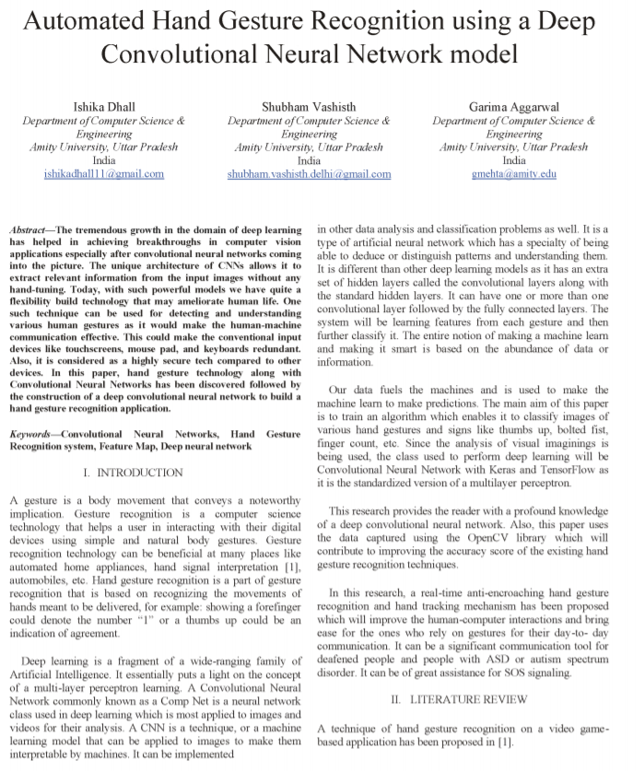
Base Paper
Paper title - Automated Hand Gesture Recognition using a Deep Convolutional Neural Network model
Paper by : Ishika Dhall
Shubham Vashisth
Garima Aggarwal
Publisher : IEEE
Published year : 2020

